Slide 1

Python OOP
Course Introduction
SoftUni Team
Technical Trainers
Software University
https://softuni.bg/

Slide 2
Table of Contents
Course Objectives
Training and Team
Course Organization
Course Infrastructure
Evaluation Criteria
2

Slide 3
Have a Question?
sli.do
#python-advanced

Slide 4

Course Objectives

Slide 5
Python OOP Objectives
Understand the OOP paradigm
Creating a hierarchy of classes and inheritance
Working with Iterators and Generators
Applying the OOP principles
Component testing
Working with decorators
5

Slide 6
Practical Programming Exam
3 practical problems for 4 hours:
Create a simple project that
Follows the OOP principles
Implements functionality based on a description
Test a provided class
Automated judge system with real-time feedback
Upload a zip project to the judge system
6

Slide 7
Theoretical Exam
You will have 30 minutes once you enter
Multiple-choice with 1 correct answer
English
Automated quiz system
Available online the day of the practical exam
You can submit your answers just one time
7

Slide 8

The Team

Slide 9
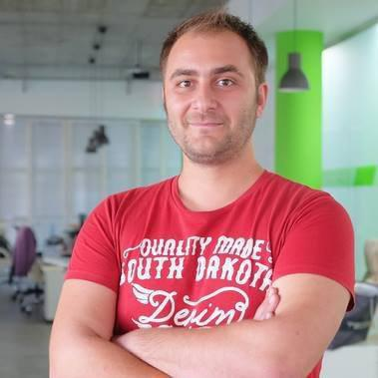
Doncho Minkov
Technical Lead & System Architect at SoftUni
10+ years in IT
9+ years experiences as a Technical trainer
Front-end developer by heart
Software developer by need
Polyglot in IT
Python, JavaScript, .Net, C/C++, Java
Django, Flask, Node.JS
DevOps, System Administration
"30 under 30" – Forbes 2017 - Education

Slide 10
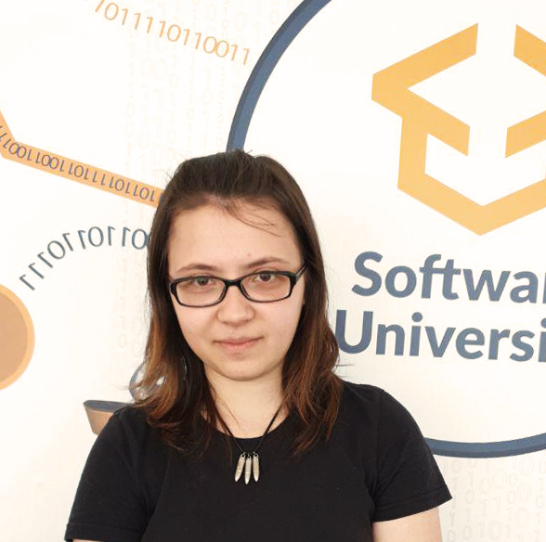
Tanya Staneva
Technical Trainer and Program Lead at SoftUni
SoftUni Top Student
Passionate about Python technologies
Interested in Machine Learning and AI

Slide 11

Course Organization

Slide 12
Python Advanced Course
27-Feb-2020
5-Apr-2020
10-Apr-2020
Python OOP
6 weeks * 4 times / week
15 credits
Start: 27-Feb-2020
Theoretical Exam: 5-Apr-2020
Final exam: 5-Apr-2020
Re-Take Exams
Тheoretical Exam: 10-Apr-2020
Final Exam Retake : 10-Apr-2020

Slide 13

Homework Assignments & Exercises
Your homework is mainly work in class
Lesson days → slides + live demos + exercises
Exercise days → only exercises
How to submit your homework?
Submitted in the judge system
Do your homework when it's due
Assignments pile up quickly

Slide 14



Scoring System for the Course
Theoretical Exam 5%
Practical Exam 90%
Presence in class 5%
Evaluation
Homework 5 %
14

Slide 15


Course Web Site, Forum and FB Group
Official web site:
Official Facebook group:
Softuni Python Community group:
https://softuni.bg/courses/python-oop
facebook.com/groups/FundamentalsModuleSeptember2019/
https://www.facebook.com/groups/SoftUniPythonCommunity

Slide 16
Questions?
Notes:
16

Slide 17












SoftUni Diamond Partners

Slide 18




SoftUni Organizational Partners

Slide 19
Trainings @ Software University (SoftUni)
Software University – High-Quality Education, Profession and Job for Software Developers
softuni.bg, softuni.org
Software University Foundation
softuni.foundation
Software University @ Facebook
facebook.com/SoftwareUniversity
Software University Forums
forum.softuni.bg
19
Notes:
19

Slide 20

License
This course (slides, examples, demos, exercises, homework, documents, videos and other assets) is copyrighted content
Unauthorized copy, reproduction or use is illegal
© SoftUni – https://softuni.org
© Software University – https://softuni.bg
Notes:
20

